Slide 1
Useful tools pt. 1

Slide 2
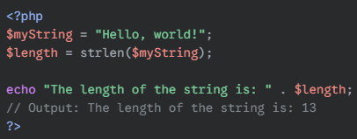
Length of a string
Check how many characters is in a string

Slide 3
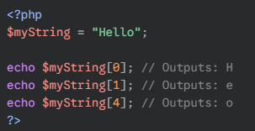
Accessing individual characters in a string
Like Python, you can treat a string in a variable as a list and access specific characters.

Slide 4
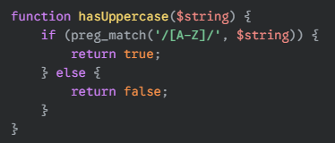
Check for Uppercase
Use preg_match
Returns True is A – Z in cap is featured in the string, false if not.

Slide 5
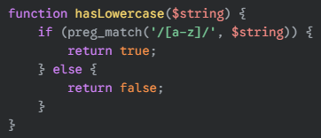
Check for lowercase
Use preg_match
Returns True is a - z in cap is featured in the string, false if not.

Slide 6
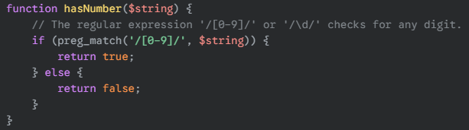
Check for a digit
Use preg_match
Returns True is 0 – 9 in cap is featured in the string, false if not.

Slide 7
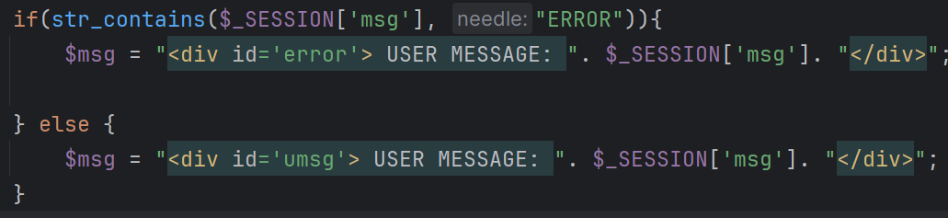
If a string exists in another string
use str_contains to look for a substring inside another string.

Slide 8
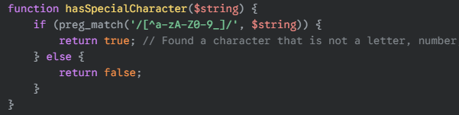
Looking for a special character
Again use preg_match
It whitelists and looks for anything not in the list given (green text)

